Slide 1

Sales Analysis Report
Excel Dashboard & Insights
By Raj Singh
LinkedIn: www.linkedin.com/in/raj-the-analyst
GitHub: https://github.com/SinghRaj09
StellarMart

Slide 2


Problem Statement
You are tasked with analyzing StellarMart's business data to provide actionable insights for strategic growth. StellarMart is a mid-sized retail chain specializing in Electronics, Clothing, Home Appliances, Books, and Groceries. Faced with growing competition and shifting customer preferences, the company aims to leverage data-driven insights to optimize operations and boost profitability.
Business Problem
Sales Decline in Categories: Some categories thrive, other stagnate.
Seasonal Trends: Suspected but not clearly visible.
Regional Performance: Unequal contribution, management need clarity.
By Raj Singh

Slide 3


Project Objectives
Identify sales trends (monthly & seasonal).
Compare sales across product categories, find underperformers.
Analyze category-wise regional contributions.
Build dashboards to visualize trends & insights.
Dataset Overview
Period: 2023–2024
Orders: 5,000
Total Sales: $13.32M
Fields: Transaction ID, Date of Sale, Product Name, Category, Region,
Quantity Sold, Sale Price, Total sale
By Raj Singh

Slide 4

Methodology
Data Cleaning → Date formatting, missing values handled
Pivot Tables → For KPIs (Sales, Profit, Orders, Quantity)
QA Analysis → Anwer the questions with Insights.
Dashboards → Built two interactive dashboards with slicers & charts
By Raj Singh

Slide 5
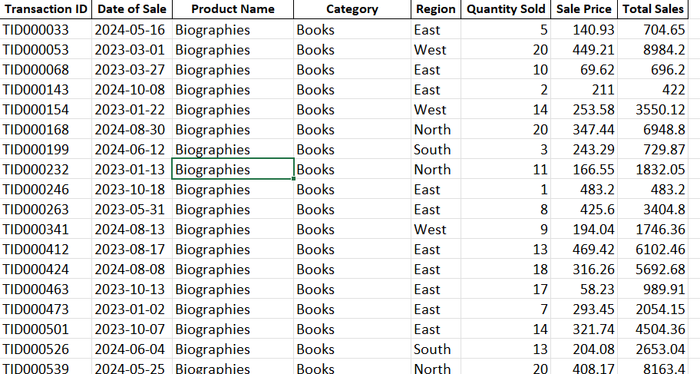
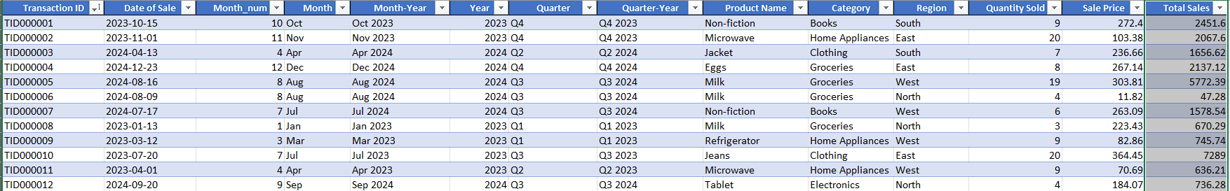
Dataset Snapshot: Before & After Cleaning
Full Dataset: https://github.com/SinghRaj09/StellarMart-Retail-Analytics/tree/main/1.%20Dataset
By Raj Singh

Slide 6
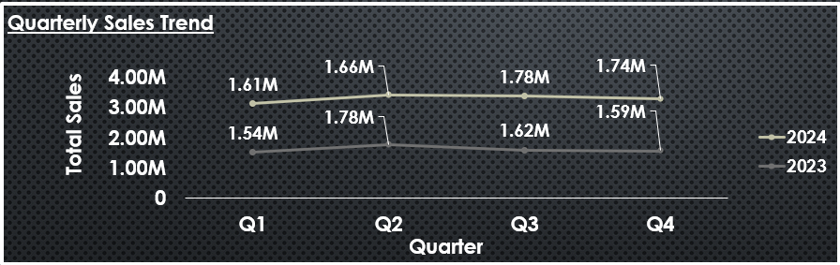
Analysis & Insights (Q&A)
1. Sales Trends (Time-based)
Q1. How have total sales changed quarter by quarter over the last two years?
2024 higher than 2023 across all quarters
Q3 in 2023 & Q2 in 2024 are the strongest quarter
Q2. Which month had the highest sales and which had the lowest?
November 2024 recorded the peak sales at $667K
February 2023 had the lowest sales at $427K
By Raj Singh

Slide 7
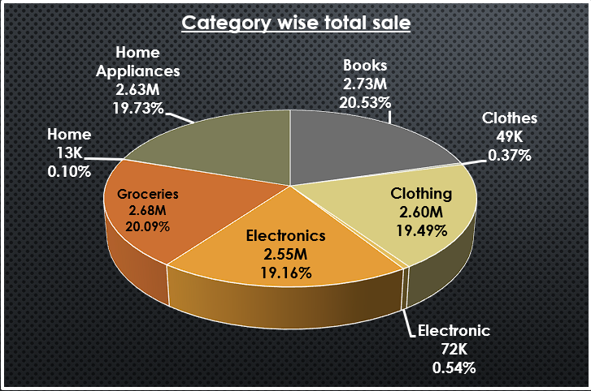
2. Category Performance
Q3. Which product category contributes the most to total sales?
Books are the top-selling category, contributing the highest share (20.53%).
By Raj Singh

Slide 8


3. Regional Insights
Q4. Which region generates the most revenue overall?
West leads with 25.54% of revenue, making it StellarMart’s strongest market.
Q5. Which category is most popular in each region?
East → Clothing ($6,95,626.82) dominates sales.
North → Electronics ($6,61,493.11) leads the region.
South → Groceries ($7,45,149.39) are the top-selling category.
West → Electronics ($6,69,885.65) generates the most revenue.
By Raj Singh

Slide 9
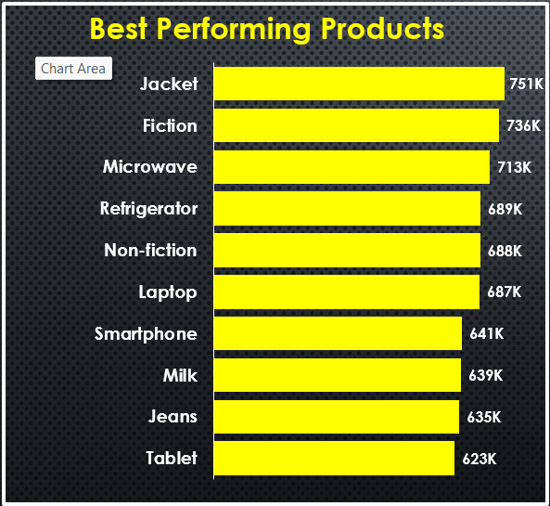
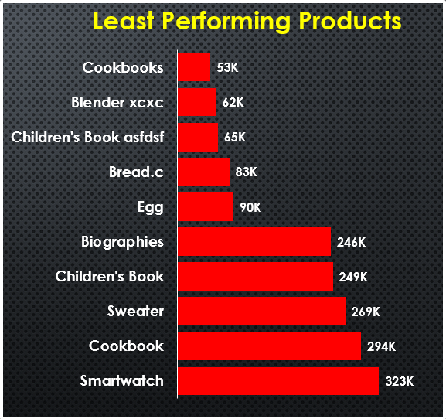
4. Product Analysis
Q6. What are the Top 10 products by sales? Q7. Which products are low-selling (bottom 10)?
By Raj Singh

Slide 10
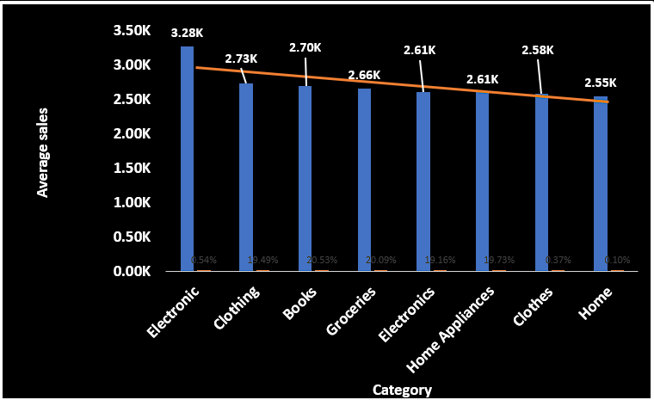
3. Quantity & Pricing Insights
Q8. Which category has the highest average sale price per product?
Electronics dominate with the highest average price per product.
By Raj Singh

Slide 11
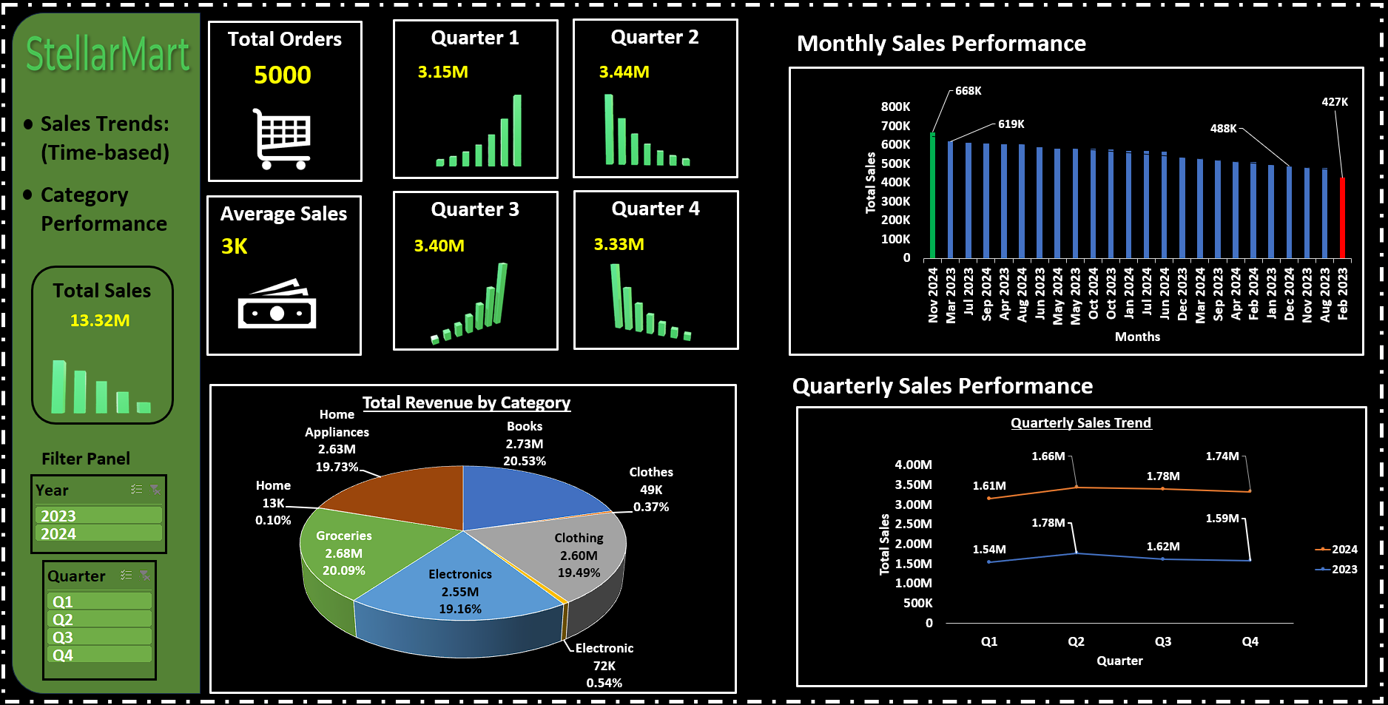
Dashboard 1

Slide 12
Time-Based and Category-Wise Sales Performance Dashboard 1
KPIs (Top-left Section)
Total Orders (5000) → Shows the total number of customer orders in the selected period.
Average Sales (3K) → Average revenue per order or transaction.
Total Sales (13.32M) → Key metric showing the overall revenue across the dataset.
Quarterly Sales Cards (Q1: 3.15M, Q2: 3.44M, Q3: 3.40M, Q4: 3.33M) → Snapshot of revenue performance across quarters. Helps compare which quarter performed best (Q2 leads at 3.44M).
2. Charts
Monthly Sales Performance (Top-right)
A bar chart showing month-by-month sales.
Labels highlight highest month (668K) and lowest month (427K) for easy comparison.
Quarterly Sales Performance (Bottom-right)
A line chart comparing quarterly sales trends across two years (2023 vs 2024).
Helps spot year-over-year growth and seasonal patterns.
Total Revenue by Category (Bottom-left)
A pie chart showing contribution of each category (Books 20.53%, Groceries 20.09%, etc.).
Makes it easy to identify leading contributors (Books, Groceries) and weaker ones (Clothes, Home).
3. Filters (Left Panel)
Year Filter (2023, 2024) → Lets users view sales metrics for specific years or compare both.
Quarter Filter (Q1–Q4) → Allows drilling into quarterly performance dynamically.
4. Insights Enabled
Sales Trends (Time-based): Quarterly & monthly sales patterns.
Category Performance: Which categories contribute most to revenue.
KPI Tracking: Total sales, total orders, and average sales at a glance.
Comparisons: Sales trend across years (2023 vs 2024).
Filtering Power: Interactivity to analyze year-wise and quarter-wise.
By Raj Singh

Slide 13
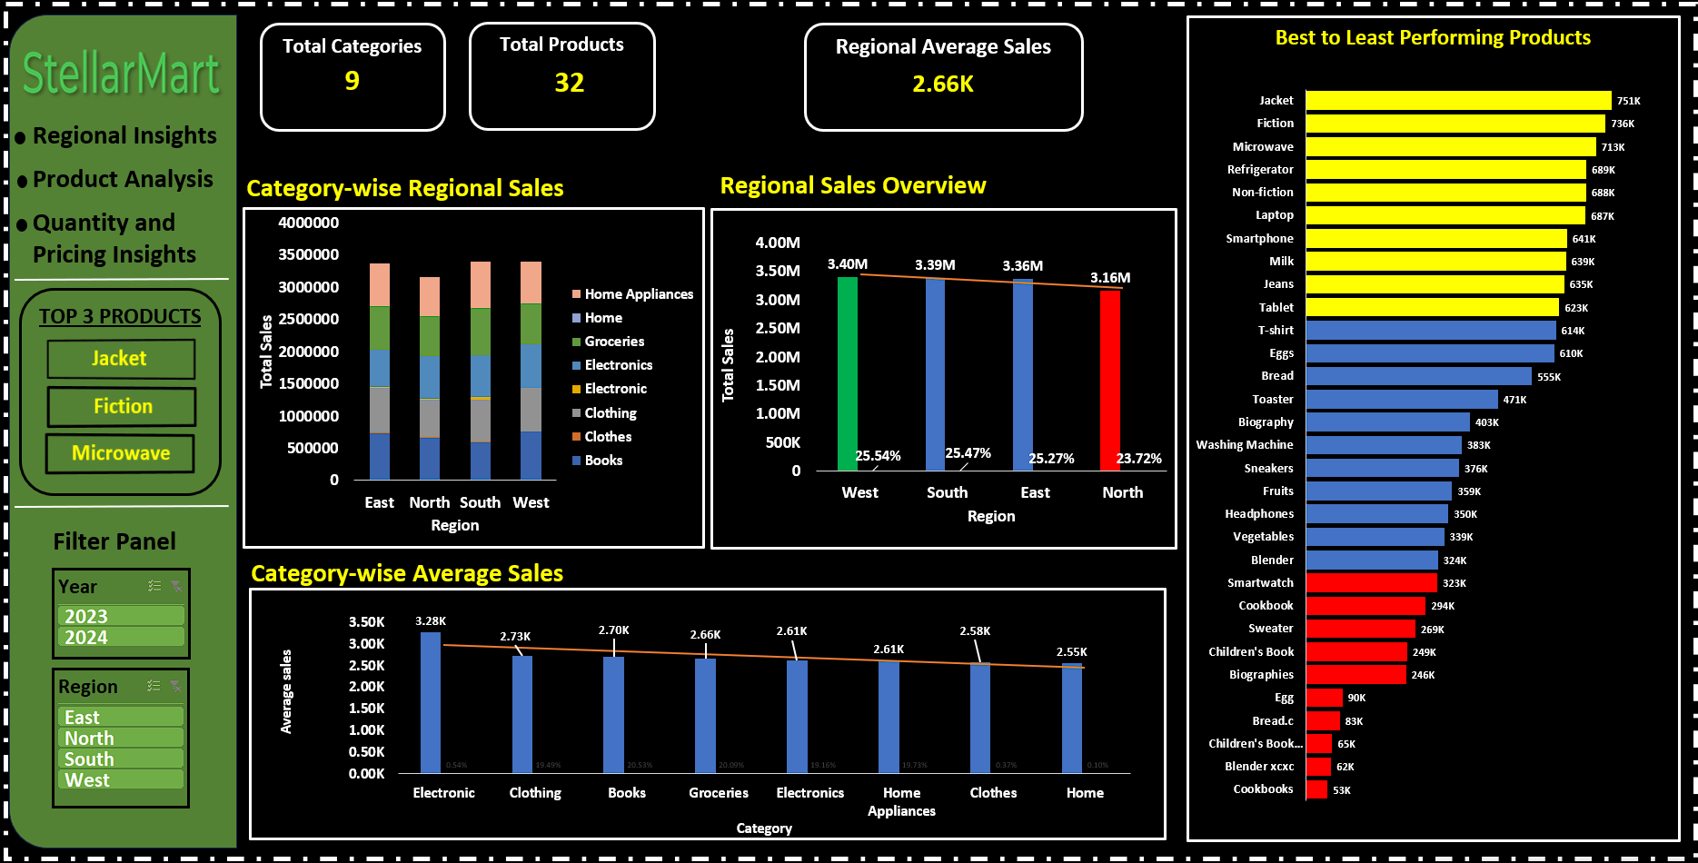
Dashboard 2

Slide 14
Sales Insights: Regional, Category, and Product Analysis
KPIs (Top Section)
Total Categories (8) → Number of product categories being analyzed.
Total Products (33) → Total distinct products in the dataset.
Regional Average Sales (3K) → Average sales value per product across regions.
2. Charts
Category-wise Regional Sales (Top-left): Shows category contribution by region.
Regional Sales Overview (Top-middle): Compares total revenue across 5 regions.
Best to Least Performing Products (Top-right): Ranks products from best to worst.
Category-wise Average Sales (Bottom): Displays average sales per category.
3. Filters (Left Sidebar)
Year Filter (2023, 2024) → Allows selection of single or multiple years.
Region Filter (East, North, South, West) → Enables region-level drilldowns for all charts/KPIs.
4. Insights Enabled
Regional Insights: Which region contributes the most sales.
Product Analysis: Best & worst performing products.
Category Insights: Sales contribution and average performance by category.
Quantity & Pricing Insights: Products/categories that sell high volumes but generate lower revenue.
Interactivity: Year and region slicers allow dynamic filtering for customized views.
By Raj Singh

Slide 15
Conclusion
Key Takeaways
West region is the strongest market, contributing the highest share of total revenue.
Electronics and Books are leading categories, driving consistent sales growth.
Clothing and Home categories underperform, showing weak revenue contribution.
Top products (Jacket, Fiction, Microwave) are major sales drivers, while several low-performing products
may not be profitable.
Recommendations
Expand in the West region and replicate its strategies in underperforming regions like North.
Revisit pricing strategies to improve revenue from high-quantity but low-value products.
Optimize product portfolio by focusing on top-performing categories and considering discontinuation of
consistently low-selling products.
Promote mid-performing categories (Groceries, Home Appliances) with targeted marketing to unlock
additional growth potential.

